Slide 1

Introduction to the Club
PAAC
Progressive Action and Advocacy Club
Meeting 1 - 9/3/2025

Slide 2
Introduction - Systems
  Every aspect of the club, in theory, can be changed via democratic vote. Aspects such as the Crew system, leadership, etc.
  The minimum number of suggestions needed to prompt a group vote will be 4 anonymous suggestions.
  Votes will always be held to decide initiative once a month.

Slide 3



The Crew System
Research
Networking
Charity

Slide 4



The Crews
Networking Crew
Charity Crew
Research Crew
This crew creates and posts on social media/website in conjunction with the research crew. They also create posters and signs for raising awareness or protesting.
This crew will research and engage in different ways that we can help our community through charity support and volunteer work
This group focuses on researching political issues, contacting reps, coming up with topics to be used for the network crew, and writing about politics.
This group finds initiatives for the club to focus on.

Slide 5
Crew Representatives
Alternatively to everything else, crew reps can be elected in any way the group sees fit. Similarly, that crew rep can act in any way the group chooses.
The rep can act as a leader and organizer, or even just a figurehead.
The only rule is that crew leaders must change every month and can not be the same for 2 consecutive months
The crew can also choose not to have a leader at all and just have a representative to contact other crews.

Slide 6
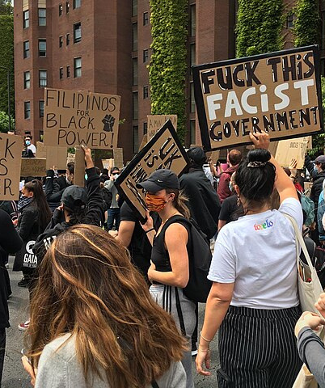
Introduction - Initiatives
Selecting an initiative
  We will pool suggestions from members
  (does not follow the same ‘4’ system as for larger club changes, every suggestion will be considered)
  Every suggestion will be placed on a rank choice voting sheet by members and they will rank each possible initiative from best to worst with 1 being the highest and the total number of choices being the lowest.

Slide 7
Conclusion
Please stay tuned for our meeting times over the coming weeks. We were originally planning on meeting during advisory every Wednesday, however, we may have too many people in the club to make that happen. The club leaders are discussing alternative meeting solutions for the club, the most likely one being meeting in the auditorium, or somewhere outside of school hours. Meeting dates and times will be kept up-to-date on our website, https://paac.grissomhighschool.org

Slide 8
Thank you

